Slide 1
CPE 404
Computer Hardware Design
Dr Osama Hosameldeen
Spring 2021
Lecture 2
Boolean Expression Simplification

Slide 2
Contents
Basic Boolean Identities
Circuit Optimization (K-Maps)
Map Manipulations (Prime Implicants)
Notes:
School of Engineering

Slide 3
Boolean Identities

Slide 4
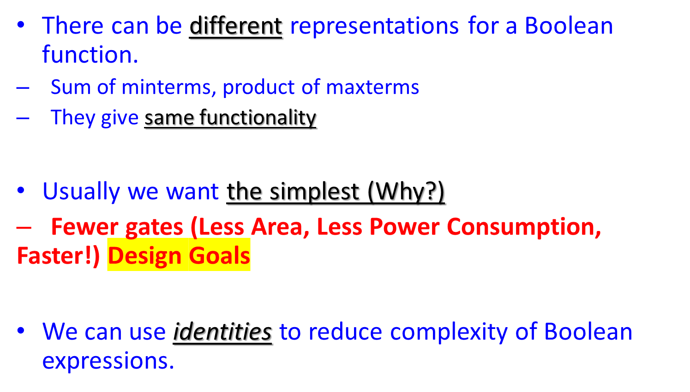
Boolean Functions:
Complexity

Slide 5
Boolean Algebra & Identities
When a Boolean function is expressed as Sum of Minterms or Product of Maxterms it can be further minimized.
Boolean Algebra is a useful tool for simplifying digital circuits.
We can use identities to manipulate functions and reduce their complexity.
We will first introduce:
  Dual of a function
  Identities
  K-Maps

Slide 6
Dual of an Expression
The dual of an expression is obtained by:
  Changing AND to OR, and
  Changing OR to AND throughout
  Changing 1’s to 0’s, and
  Changing 0’s to 1’s
For example
  The dual of X+0 is:
    X.1,
  The dual of X.0 is:
    X+1

Slide 7
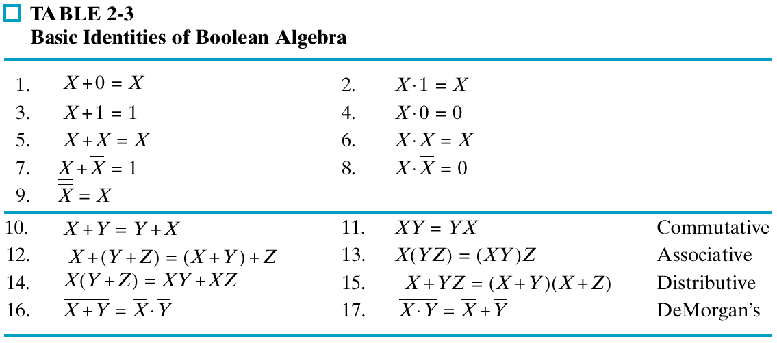
Table of Identities

Slide 8
Duals
Left and right columns are duals
Recall, a dual is obtained by:
  Changing AND to OR and OR to AND throughout
  Changing 1’s to 0’s and 0’s to 1’s

Slide 9
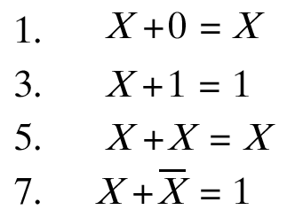
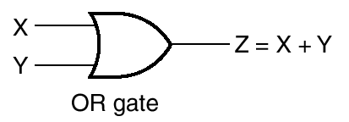
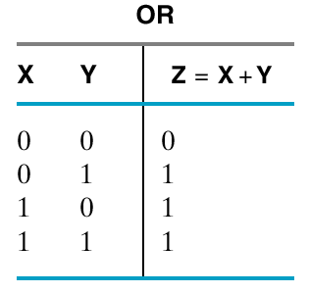
Single Variable Identities
X
X
0
X
X
X
1
1
5V
Output

Slide 10
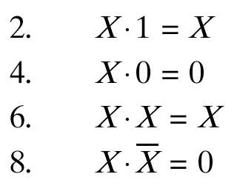

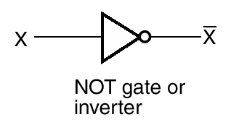
Single Variable Identities
Dual
X
X

Slide 11
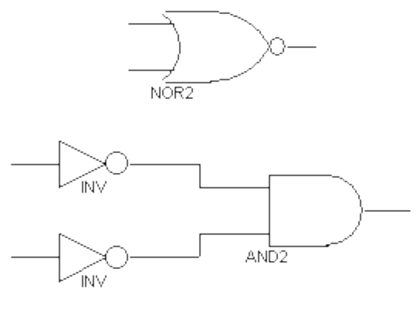

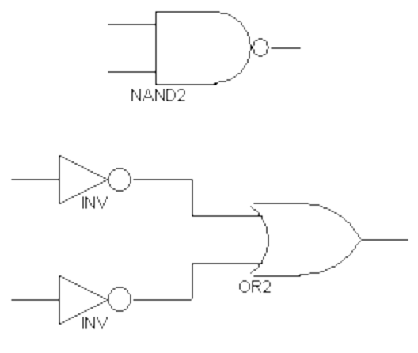

DeMorgan’s Theorem
Used a lot
NOR equals invert AND
NAND equals invert OR
Proof?

Slide 12
Simplification: Example

Slide 13
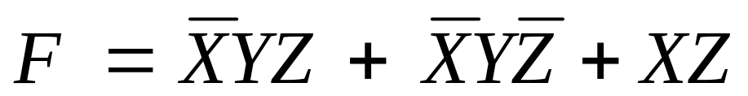
Algebraic Manipulation
When a Boolean equation is implemented with logic gates,
  Each term requires a gate,
  Each variable designates an input to the gate.
We define a literal as a single variable within a term that may or may not be complemented.
The expression above has 3 terms and 8 literals.

Slide 14
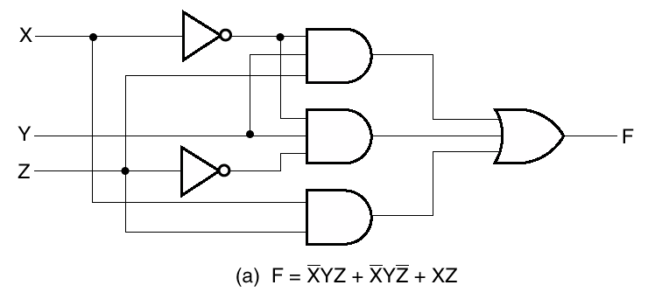
Algebraic Manipulation
Consider function
How many gates do we need to implement this function?

Slide 15
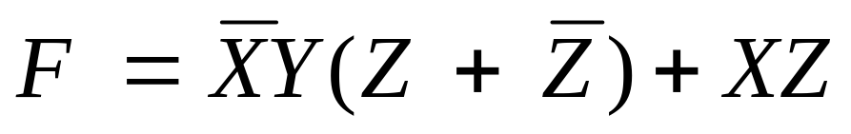

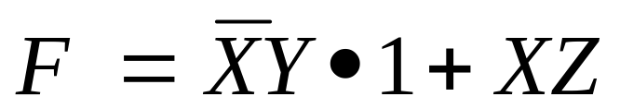

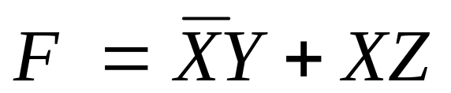
Simplify Function
Apply
Apply
Apply
End Result?

Slide 16
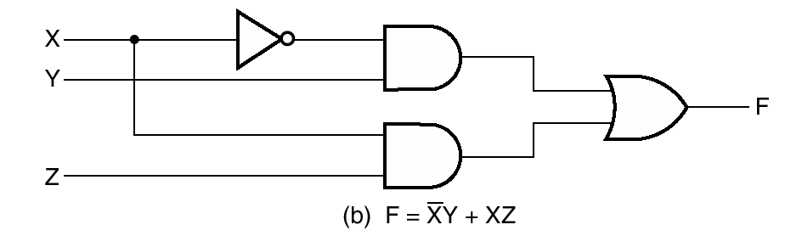
Fewer Gates
Fewer Gates!
Fewer Inputs per gate!

Slide 17
Duality Principle

Slide 18
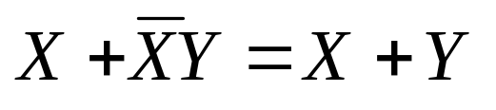
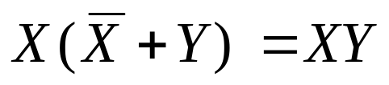
The Duality Principle
Recall how to obtain the dual of an expression!
The duality principle states that a Boolean equation remains valid if we take the dual of the expression on both sides of the equal sign.

Slide 19
Complement of a Function

Slide 20
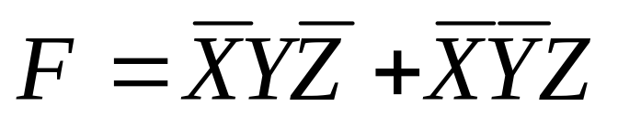
1. Complement of a Function
The complement representation for a function F, (F’), is obtained from an interchange of 1’s to 0’s and 0’s to 1’s for the values of F in the truth table.
X | Y | Z | F | F
0 | 0 | 0 | 0 | 1
0 | 0 | 1 | 1 | 0
0 | 1 | 0 | 1 | 0
0 | 1 | 1 | 0 | 1
1 | 0 | 0 | 0 | 1
1 | 0 | 1 | 0 | 1
1 | 1 | 0 | 0 | 1
1 | 1 | 1 | 0 | 1

Slide 21
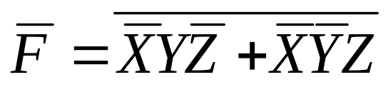
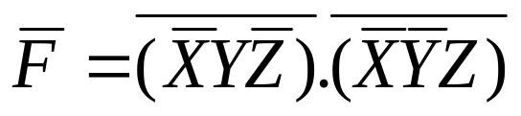
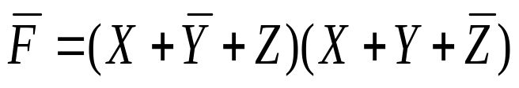
2. Cont ..Complement of a Function
The complement of a function can be derived algebraically by applying DeMorgan’s theorem.
Complement the left hand side and the right hand side by putting a bar on top of each.

Slide 22
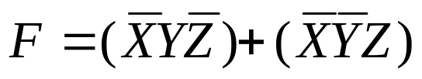
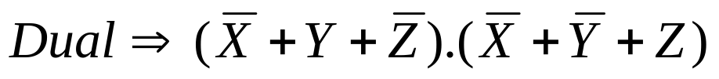
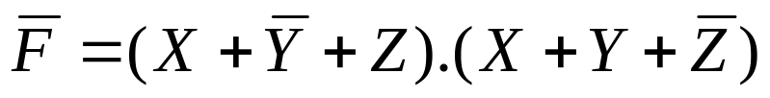
3. Cont ..Complement of a Function
Yet another way of deriving the complement of a function is to:
  Take the dual of the function equation
  Complement each literal.

Slide 23
Circuit Optimization
K-Maps

Slide 24
Two-Level Circuit Optimization
The complexity of the digital logic gates that implement a Boolean function is directly related to the algebraic expression from which the function is implemented!!
Boolean expressions may be simplified by algebraic manipulation (i.e. identities) but!
  It is awkward and
  Not straight forward!
  We don’t even know when to stop!!

Slide 25
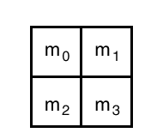
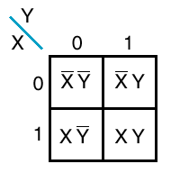
Karnaugh Maps
Graphical depiction of truth table
A box for each minterm
  So 2 variables, 4 boxes
  3 variable, 8 boxes
  4 variables, 16 boxes
Useful for simplification
  By inspection
  Algebraic manipulation harder
2-Variables

Slide 26
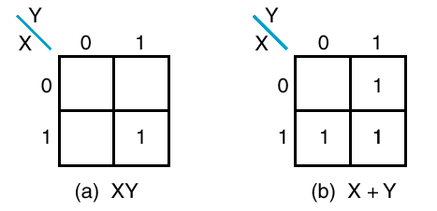
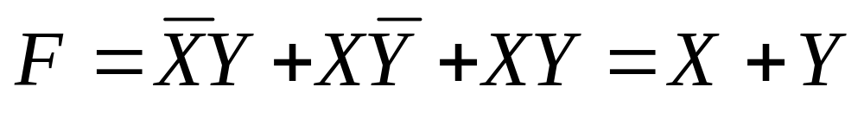
Examples
X’Y
XY
XY
There are implied 0s in other boxes
Figure (b) F = m₁ + m₂ + m₃
How do we simplify the sum of minterms to highlighted expression?

Slide 27
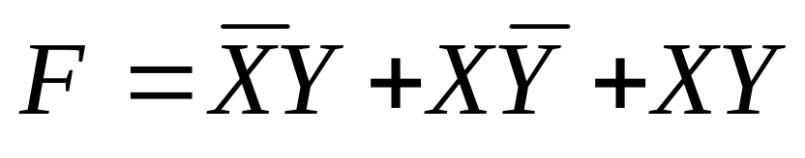
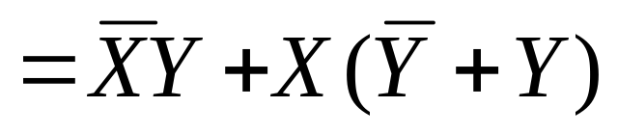
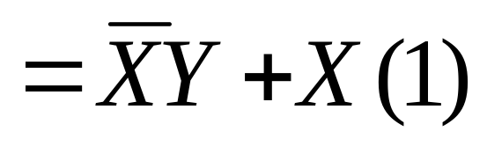
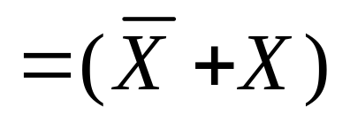
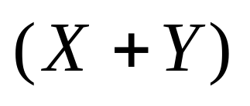
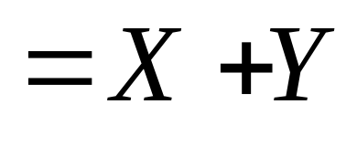
Simplification

Slide 28
K-Maps: 3 Variable Map

Slide 29
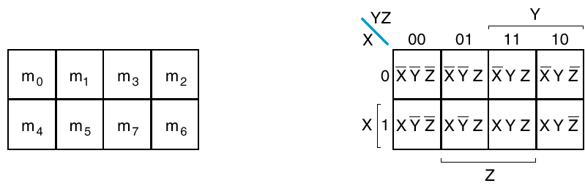
Three-Variable Map
Eight minterms
Look at encoding of columns and rows
Only one variable changes from box to box

Slide 30
Simplification
Adjacent squares (horizontally or vertically) are minterms that vary by single variable
Draw rectangles on map to simplify function
Illustration next

Slide 31
How to obtain a simplified expression?
Combine as many 1’s as possible from the map to form a rectangle
Only adjacent 1’s can be combined:
  Vertically or
  Horizontally
  but not diagonally.
The number of 1’s that can be combined is a power of 2,
  (2⁰=1, 2¹=2, 2²=4, 2³=8), …

Slide 32
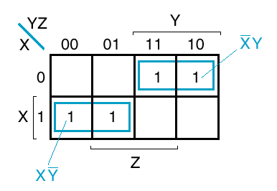
Example
YZ
00
01
11
10
X
X | Y | Z | F
0 | 0 | 0 | 0
0 | 0 | 1 | 0
0 | 1 | 0 | 1
0 | 1 | 1 | 1
1 | 0 | 0 | 1
1 | 0 | 1 | 1
1 | 1 | 0 | 0
1 | 1 | 1 | 0
0
m₀
1
m₁
m₂
m₃
m₄
m₅
m₆
m₇

Slide 33

Example
YZ
00
01
11
10
X
0
X | Y | Z | F
0 | 0 | 0 | 0
0 | 0 | 1 | 0
0 | 1 | 0 | 1
0 | 1 | 1 | 1
1 | 0 | 0 | 1
1 | 0 | 1 | 1
1 | 1 | 0 | 0
1 | 1 | 1 | 0
m₀
1
m₁
m₂
m₃
m₄
m₅
m₆
m₇

Slide 34


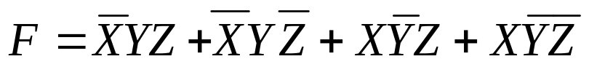

Extract minterms from
Expression
YZ
00
01
11
10
X
0
1
1
1
1
1

Slide 35

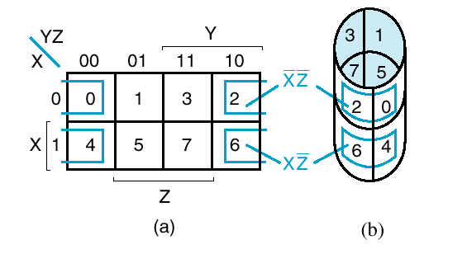
Adjacency is Cylindrical
Note that wraps from left edge to right edge.

Slide 36
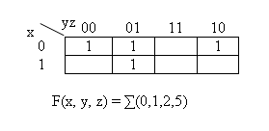
Another Minimization Example
Each of the two adjacent pairs of entries can be simplified by eliminating the changing bit.
  x is eliminated in column 2
  y is eliminated in the other pair.
  F = y’z + x’z’
X’Z’
Y’Z
Notes:
School of Engineering

Slide 37
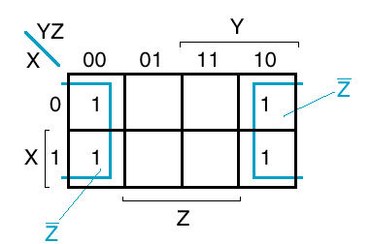
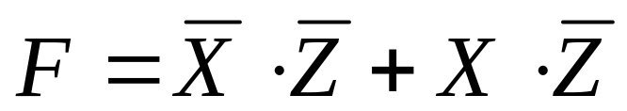
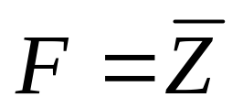
Covering 4 Squares
is

Slide 38
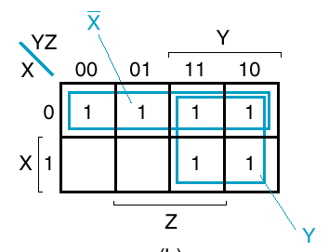
Another Example
F = X’ + Y
In general, as more squares are combined, we obtain a product term with fewer literals.
Overlap is allowed.

Slide 39
Three Variable Maps
Three variable maps exhibit the following characteristics:
  One box represents minterm with 3 literals
  Rectangle of 2 boxes -> 2 literals
  Rectangle of 4 boxes -> 1 literal
  Rectangle of 8 boxes -> Logic 1 (on 3-variable map)

Slide 40
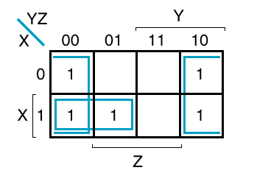

Slight Variation
Overlap is OK.
No need to use full m₅-- waste of input

Slide 41
K-Maps: 4 Variable Map

Slide 42
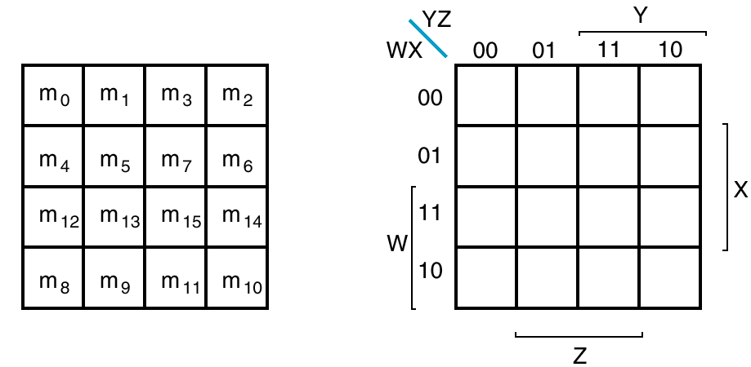
4-Variable Map
At limit of K-map

Slide 43
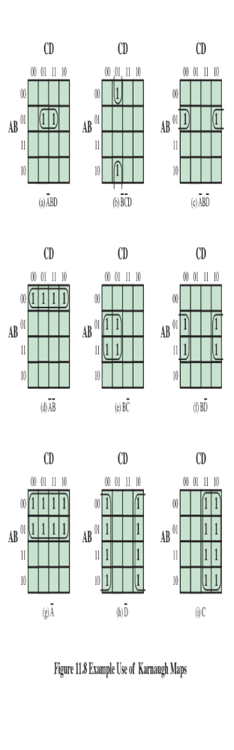
Give Expression for F
?
?
?
Notes:
Once the map of a function is created, we can often write a simple algebraic expression for it by noting the arrangement of the 1s on the map. The principle is as follows. Any two squares that are adjacent differ in only one of the variables. If two adjacent squares both have an entry of one, then the corresponding product terms differ in only one variable. In such a case, the two terms can be merged by eliminating that variable.
This process can be extended in several ways. First, the concept of adjacency can be extended to include wrapping around the edge of the map. Thus, the top square of a column is adjacent to the bottom square, and the leftmost square of a row is adjacent to the rightmost square. These conditions are illustrated in Figures 11.8b and c. Second, we can group not just 2 squares but 2^{n} adjacent squares (i.e., 2, 4, 8, etc.). The next three examples in Figure 11.8 show groupings of 4 squares. Note that in this case, two of the variables can be eliminated. The last three examples show groupings of 8 squares, which allow three variables to be eliminated.
We can summarize the rules for simplification as follows:
1. Among the marked squares (squares with a 1), find those that belong to a unique largest block of 1, 2, 4, or 8 and circle those blocks.
2. Select additional blocks of marked squares that are as large as possible and as few in number as possible, but include every marked square at least once. The results may not be unique in some cases. For example, if a marked square combines with exactly two other squares, and there is no fourth marked square to complete a larger group, then there is a choice to be made as two which of the two groupings to choose. When you are circling groups, you are allowed to use the same 1 value more than once.
3. Continue to draw loops around single marked squares, or pairs of adjacent marked squares, or groups of four, eight, and so on in such a way that every marked square belongs to at least one loop; then use as few of these blocks as possible to include all marked squares.

Slide 44
Give Expression for F
?
?
?
Notes:
Once the map of a function is created, we can often write a simple algebraic expression for it by noting the arrangement of the 1s on the map. The principle is as follows. Any two squares that are adjacent differ in only one of the variables. If two adjacent squares both have an entry of one, then the corresponding product terms differ in only one variable. In such a case, the two terms can be merged by eliminating that variable.
This process can be extended in several ways. First, the concept of adjacency can be extended to include wrapping around the edge of the map. Thus, the top square of a column is adjacent to the bottom square, and the leftmost square of a row is adjacent to the rightmost square. These conditions are illustrated in Figures 11.8b and c. Second, we can group not just 2 squares but 2^{n} adjacent squares (i.e., 2, 4, 8, etc.). The next three examples in Figure 11.8 show groupings of 4 squares. Note that in this case, two of the variables can be eliminated. The last three examples show groupings of 8 squares, which allow three variables to be eliminated.
We can summarize the rules for simplification as follows:
1. Among the marked squares (squares with a 1), find those that belong to a unique largest block of 1, 2, 4, or 8 and circle those blocks.
2. Select additional blocks of marked squares that are as large as possible and as few in number as possible, but include every marked square at least once. The results may not be unique in some cases. For example, if a marked square combines with exactly two other squares, and there is no fourth marked square to complete a larger group, then there is a choice to be made as two which of the two groupings to choose. When you are circling groups, you are allowed to use the same 1 value more than once.
3. Continue to draw loops around single marked squares, or pairs of adjacent marked squares, or groups of four, eight, and so on in such a way that every marked square belongs to at least one loop; then use as few of these blocks as possible to include all marked squares.

Slide 45
Give Expression for F
?
?
?
Notes:
Once the map of a function is created, we can often write a simple algebraic expression for it by noting the arrangement of the 1s on the map. The principle is as follows. Any two squares that are adjacent differ in only one of the variables. If two adjacent squares both have an entry of one, then the corresponding product terms differ in only one variable. In such a case, the two terms can be merged by eliminating that variable.
This process can be extended in several ways. First, the concept of adjacency can be extended to include wrapping around the edge of the map. Thus, the top square of a column is adjacent to the bottom square, and the leftmost square of a row is adjacent to the rightmost square. These conditions are illustrated in Figures 11.8b and c. Second, we can group not just 2 squares but 2^{n} adjacent squares (i.e., 2, 4, 8, etc.). The next three examples in Figure 11.8 show groupings of 4 squares. Note that in this case, two of the variables can be eliminated. The last three examples show groupings of 8 squares, which allow three variables to be eliminated.
We can summarize the rules for simplification as follows:
1. Among the marked squares (squares with a 1), find those that belong to a unique largest block of 1, 2, 4, or 8 and circle those blocks.
2. Select additional blocks of marked squares that are as large as possible and as few in number as possible, but include every marked square at least once. The results may not be unique in some cases. For example, if a marked square combines with exactly two other squares, and there is no fourth marked square to complete a larger group, then there is a choice to be made as two which of the two groupings to choose. When you are circling groups, you are allowed to use the same 1 value more than once.
3. Continue to draw loops around single marked squares, or pairs of adjacent marked squares, or groups of four, eight, and so on in such a way that every marked square belongs to at least one loop; then use as few of these blocks as possible to include all marked squares.

Slide 46
Give Expression for F
The more 1’s combined the simpler the expression.
Notes:
Once the map of a function is created, we can often write a simple algebraic expression for it by noting the arrangement of the 1s on the map. The principle is as follows. Any two squares that are adjacent differ in only one of the variables. If two adjacent squares both have an entry of one, then the corresponding product terms differ in only one variable. In such a case, the two terms can be merged by eliminating that variable.
This process can be extended in several ways. First, the concept of adjacency can be extended to include wrapping around the edge of the map. Thus, the top square of a column is adjacent to the bottom square, and the leftmost square of a row is adjacent to the rightmost square. These conditions are illustrated in Figures 11.8b and c. Second, we can group not just 2 squares but 2^{n} adjacent squares (i.e., 2, 4, 8, etc.). The next three examples in Figure 11.8 show groupings of 4 squares. Note that in this case, two of the variables can be eliminated. The last three examples show groupings of 8 squares, which allow three variables to be eliminated.
We can summarize the rules for simplification as follows:
1. Among the marked squares (squares with a 1), find those that belong to a unique largest block of 1, 2, 4, or 8 and circle those blocks.
2. Select additional blocks of marked squares that are as large as possible and as few in number as possible, but include every marked square at least once. The results may not be unique in some cases. For example, if a marked square combines with exactly two other squares, and there is no fourth marked square to complete a larger group, then there is a choice to be made as two which of the two groupings to choose. When you are circling groups, you are allowed to use the same 1 value more than once.
3. Continue to draw loops around single marked squares, or pairs of adjacent marked squares, or groups of four, eight, and so on in such a way that every marked square belongs to at least one loop; then use as few of these blocks as possible to include all marked squares.

Slide 47
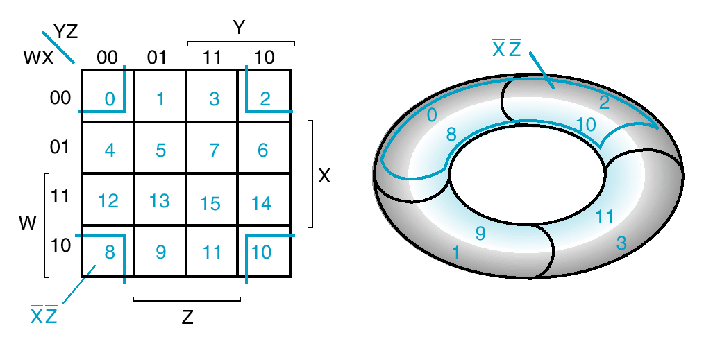
Also Wraps (toroidal topology)

Slide 48
Simplifying a 4-Variable
Function
YZ
WX
00
01
11
10
1 | 1 |  | 1
1 | 1 |  | 1
1 | 1 |  | 1
1 | 1
00
W Z
01
11
X Z
10
Y

Slide 49
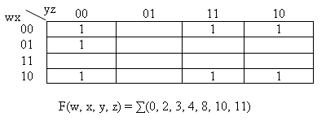
Another Example
Four adjacent corners can be combined to form the two literal term x’z’.
Four adjacent squares can be combined to form the two literal term x’y.
The remaining 1 is combined with a single adjacent 1 to obtain the three literal term w’y’z’.
F = x’z’ + x’y + w’y’z’

Slide 50
Don’t Care
So far we have dealt with functions that were always either 0 or 1
Sometimes we have some conditions where we don’t care what result is
Example: dealing with BCD
  With 4-bits we can encode 16 items
  We only care about first 10 (0000 – 1001)
  The remaining (1010 – 1111) we don’t care

Slide 51
Mark With an `X’
In a K-map, mark don’t care with an ‘X’
Leads to simpler implementations
  Can treat an X either as 1 or 0
Example:

Slide 52
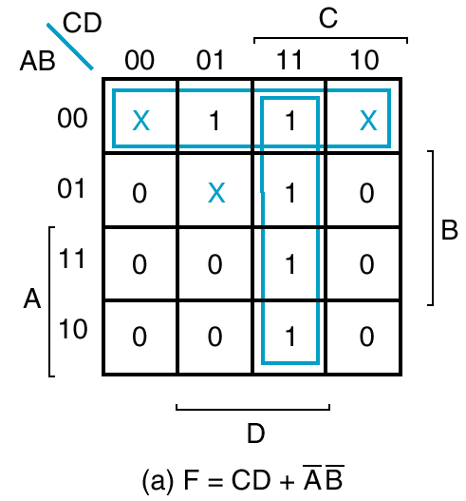
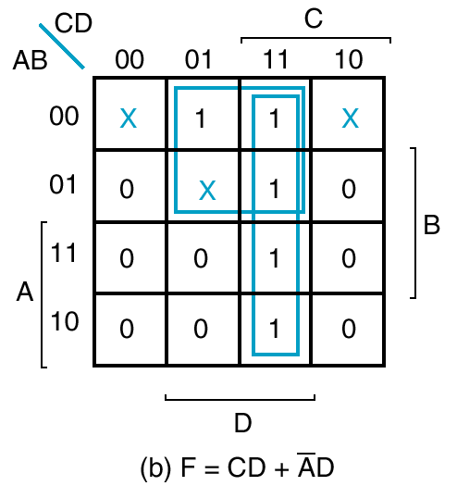
Example
or
What would we have if Xs were 0?

Slide 53

Implicants
Each element in the K-Map is an implicant.
YZ
WX
00
01
11
10
00
01
11
10

Slide 54

Prime Implicants
A prime implicant is a product term obtained by combining the maximum possible number of adjacent squares in the map.
  A single 1 on a map represents a prime implicant if it is not adjacent to any other 1.
  Two adjacent 1’s form a prime implicant, provided they are not within a group of four adjacent squares.
  Four adjacent 1’s form a prime implicant if they are not within a group of eight adjacent squares, and so on.
WX
YZ
00
01
11
10
00
1
1
prime implicant
1
1
01
11
1
1
10
1
1

Slide 55

Essential Prime Implicants
If a minterm in a square is covered by only one prime implicant, that prime implicant is said to be essential.
  They are found by looking at each square marked with a 1 and checking the number of prime implicants that cover it. Those with only one prime implicant are essential.

Slide 56



Implicant/Prime Implicant/Essential
Consider:
Each Element of f^{on} is an Implicant
Prime Implicants are:
abc is a Prime Implicant but NOT an
Essential Prime Implicant
bcd is an Implicant but NOT a
Prime Implicant
bd is an Essential Prime Implicant

Slide 57
Finding Simplified Expressions
The procedure for finding simplified expressions:
  Determine all essential prime implicants.
  The final expression is formed from the logical sum of:
    The essential prime implicants, with
    Other prime implicants needed to cover the remaining minterms
There may be more than one simplified expression.

Slide 58
Prime Implicants: Example
Two essential prime implicants (caused by m₀ and m₅)
  This gives us two terms: x’z’ and xz
Finding prime implicants for the remainders results in four expressions:
  F = xz + x’z’ + yz + wz
  F = xz + x’z’ + yz + wx’
  F = xz + x’z’ + x’y + wz
  F = xz + x’z’ + x’y + wx’

Slide 59
Prime Implicants: Example
  xz
yz
wz
wx’
x’z’
Two essential prime implicants (caused by m₀ and m₅)
  This gives us two terms: x’z’ and xz
Finding prime implicants for the remainders results in four expressions:
  F = xz + x’z’ + yz + wz
  F = xz + x’z’ + yz + wx’
  F = xz + x’z’ + x’y + wz
  F = xz + x’z’ + x’y + wx’

Slide 60
Consensus Theorem

Slide 61

Consensus Theorem
The third term is redundant
  Can just drop
What does it mean?
  For third term to be true, Y & Z both 1
  Then one of the first two terms must be 1!

Slide 62






Proof of Consensus Theorem

Slide 63
Lecture End

